Slide 1
1
SLIDE 1
ASPIRE · MATHEMATICAL RESEARCH AND INNOVATIONS
Solving for Optimal Staffing: An Inverse Queuing Approach to Equity-Weighted Physician Allocation Across New Jersey EDs
Rithvik Sharma
Academy of Mathematics, Science, & Engineering
Mentor: Professor Padhu Seshaiyer, George Mason University
ASPIRE — Mathematical Research and Innovations · August 2026
ASPIRE · Mathematical Research and Innovations
1
Notes:
Good afternoon. I'm Rithvik Sharma from the Academy of Mathematics, Science and Engineering. This work asks whether physician staffing — a quantity hospitals do not report — can be recovered from published wait times, and then reallocated under an equity constraint.

Slide 2
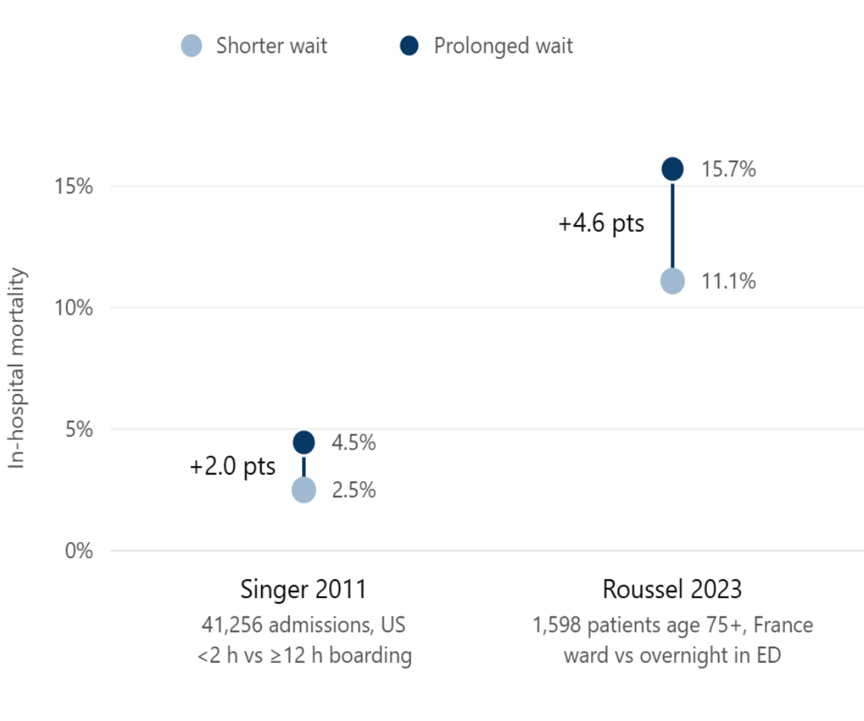

2
Motivation and Research Question
SLIDE 2
UN SDG 3 — GOOD HEALTH AND WELL-BEING
Emergency department crowding is a measurable clinical harm, not merely an operational inefficiency.
THE PROBLEM
Existing allocation models treat every hospital as identical, ignoring the socioeconomic conditions of the communities each serves. Because marginal returns on an added physician are highest at well-resourced facilities, capacity concentrates there while hospitals in higher-vulnerability counties fall further behind.
THE HIDDEN OBSTACLE
Physician staffing levels are not publicly reported. You cannot optimize what you cannot observe.
RESEARCH QUESTION
Can implied physician capacity be recovered from public wait-time data, and can that capacity be reallocated under an equity constraint without materially sacrificing aggregate efficiency?
Baselines are not comparable across cohorts; populations differ. Association, not causation.
ASPIRE · Mathematical Research and Innovations
2
Notes:
Crowding is a clinical harm with a measured mortality signal. The obstacle is that staffing is unobserved — so the research question is whether capacity can be recovered from wait times and then reallocated under an equity constraint.

Slide 3

3
Step 1: Recovering Implied Capacity
SLIDE 3
Step 1 — The Inverse Problem
Physician staffing levels are not publicly reported. But wait times are. If wait time is a known function of staffing, that function can be inverted.
FORWARD MODEL
SYMBOL
MEANING
SOURCE OR VALUE
Offered load, utilization
λ
Arrival rate at the facility (patients/hr)
Derived — see chain below
μ
Service rate per physician (patients/hr)
2.55 (EDBA; Augustine 2017)
c
Physicians on duty in parallel
UNKNOWN — solved for
Erlang C — probability an arrival waits
A = λ/μ
Offered load
Derived
ρ = A/c
Utilization
Derived
P(W)
Probability an arrival must wait (Erlang C)
Computed
Wq(c)
Expected queue wait (hours)
Model output
Expected queue wait
Wq_obs
Observed median ED wait
CMS OP_18b
scipy.optimize.brentq
THE INVERSION
def solve_implied_c(lam, wq_obs, mu):
def objective(c):
if c <= lam / mu:
return 1e9 rho, L = lam / (c * mu), lam / mu
# log-space Erlang C: factorials overflow at realistic lambda term2 = np.exp(c * np.log(L) - gammaln(c + 1) - np.log(1 - rho))
term1 = np.exp(L) * pdtr(
int(np.floor(c)) - 1 , L)
p_wait = term2 / (term1 + term2)
return p_wait / (c * mu - lam) - wq_obs
return brentq(objective, lam / mu + 0.01, 1000.0)
Λ DERIVATION CHAIN
NJSHAD county ED visits, 2024
→
× HCRIS 2023 bed share
→
÷ 8,760 hrs
→
λ per facility
Facility-level ED volume is not published, so county volume is disaggregated in proportion to licensed beds.
Search bracket runs from the stability floor λ/μ to c = 1000. Erlang C is evaluated in log space using gammaln and the Poisson CDF; direct factorial evaluation overflows at realistic arrival rates.
ASPIRE · Mathematical Research and Innovations
3
Notes:
Staffing is not reported, but wait times are. Since wait is a strictly decreasing function of staffing, that function can be inverted. Brent's method finds the unique root between the stability floor and c equals one thousand.

Slide 4
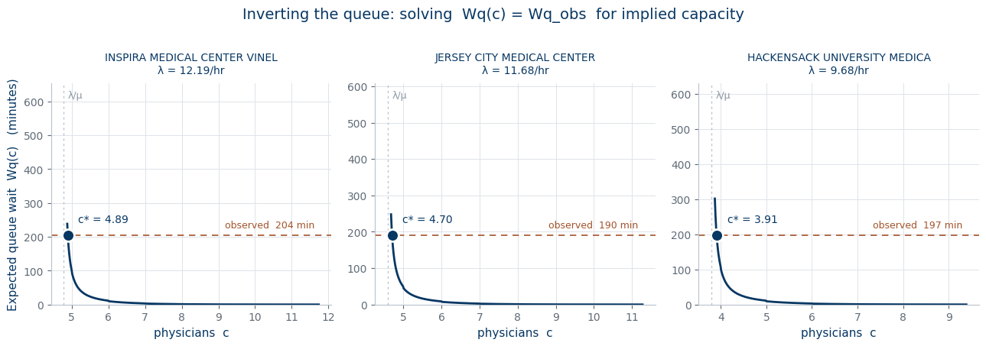
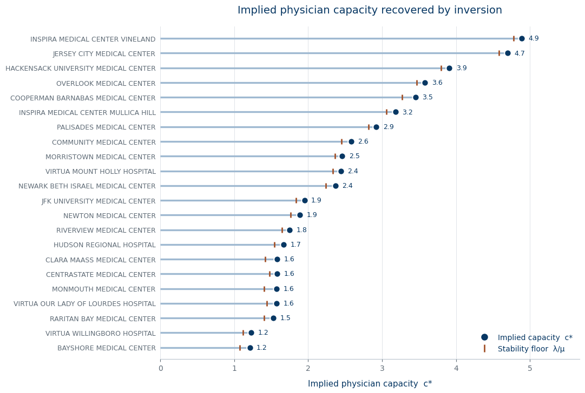
4
Step 1 Results
SLIDE 4
Step 1 — Results
Each panel plots expected queue wait against physician count for one facility. The rust line marks the observed CMS wait; the intersection is the implied capacity c*.
CONVERGED
22 of 25 facilities
NO ROOT
3 facilities
Diagnostic. For the three non-convergent facilities the observed wait falls below the model's theoretical floor even at c = 1000, indicating that λ is underestimated by the bed-share proxy at those sites rather than any failure of the solver.
Implied physician capacity recovered for each facility, with the stability floor λ/μ marked.
ASPIRE · Mathematical Research and Innovations
4
Notes:
Each panel plots the wait curve for one facility; the rust line is the observed CMS wait and the intersection is the implied capacity. Twenty-two of twenty-five facilities converged; the three that did not are a diagnosis of the arrival-rate proxy, not a solver failure.

Slide 5

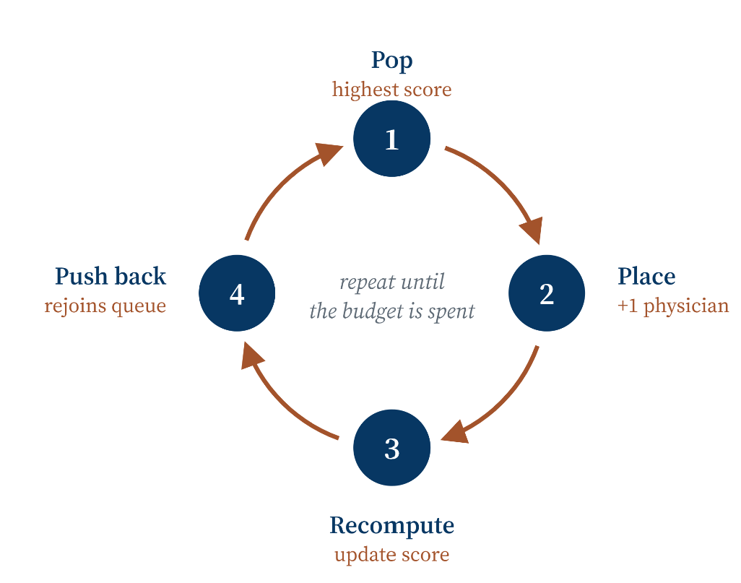
5
Step 2: Equity-Weighted Allocation
SLIDE 5
Step 2 — Allocating New Capacity
With baseline capacity recovered for every facility, the question becomes where to place additional physicians. A pure efficiency maximizer concentrates them where marginal returns are steepest, which favors well-resourced facilities. An equity weight corrects for that.
FORMULAS
SYMBOL
MEANING
SOURCE OR VALUE
C_w
Cost of one patient-hour of waiting
$120/hr
SVI
County Social Vulnerability Index
0 – 1 (CDC/ATSDR)
α
Equity weighting dial
2.0
B
Physician budget to allocate
40
OBJECTIVE
c⁰
Baseline capacity from Step 1
Solved above
MS(h,c)
Marginal savings from one more physician
Computed
w_h
Equity weight
Computed
Δ(h,c)
Equity-weighted priority score
Computed
Greedy allocation — submodular maximization
heap = [(-w[h] * MS(h, c[h]), h) for h in hospitals]
heapify(heap)
while budget > 0 :
_, h = heappop(heap)
c[h] +=
1 budget -= 1 heappush(heap, (-w[h] * MS(h, c[h]), h))
Scores are negated because Python's heapq is a min-heap; the largest weighted marginal saving is popped first. Each physician a facility receives lowers its next score, returning it to the queue behind competitors — allocation self-balances with no explicit fairness constraint.
ASPIRE · Mathematical Research and Innovations
5
Notes:
With baseline capacity recovered, the question is where to put additional physicians. A pure efficiency maximizer favors well-resourced facilities; the equity weight corrects for that, and the allocation self-balances because each added physician lowers that facility's next score.

Slide 6
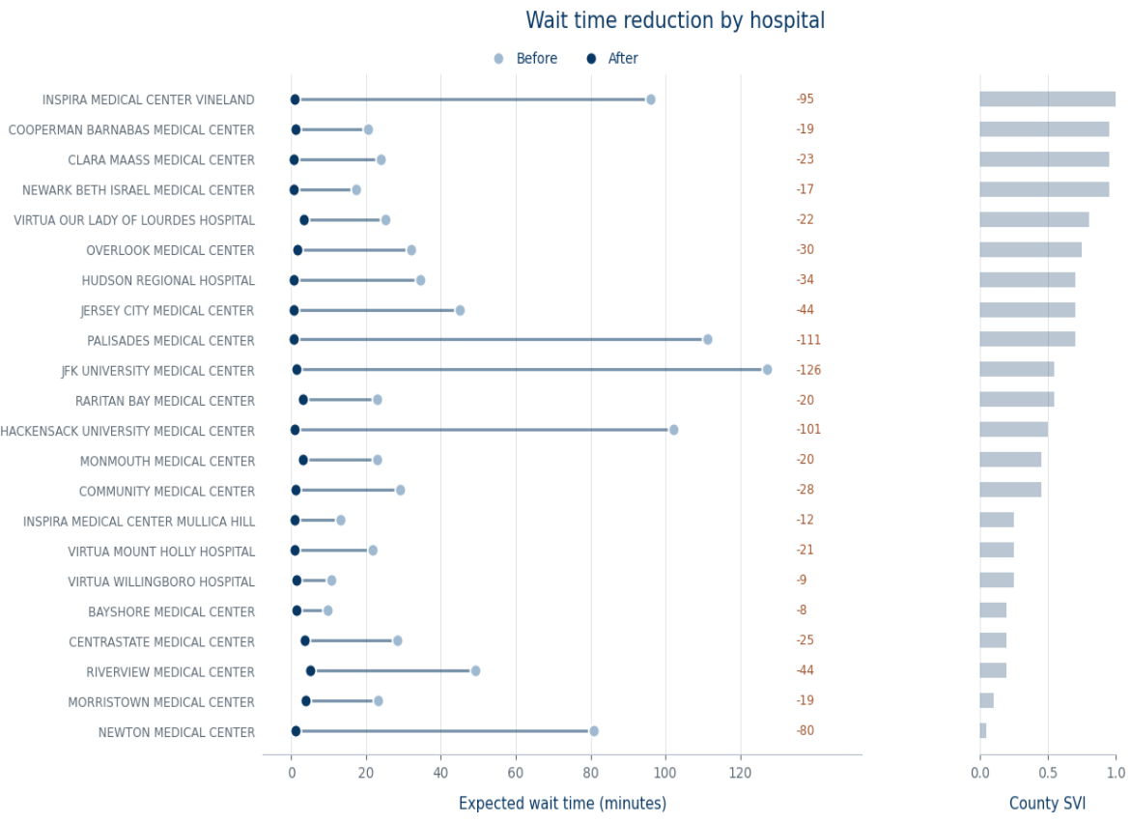
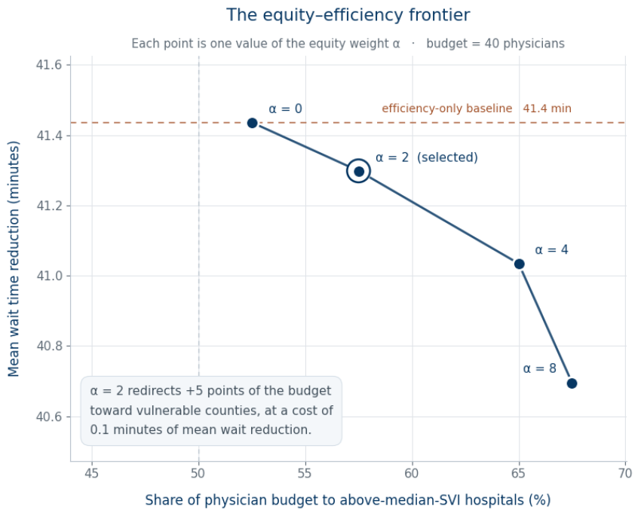
6
Step 2 Results
SLIDE 6
Step 2 — Results
MEAN WAIT TIME REDUCTION
41.30 minutes
across 22 NJ hospitals
Each point is one value of the equity weight α, at a fixed budget of 40 physicians.
Moving from α = 0 to α = 2 redirects five additional percentage points of the budget toward vulnerable counties at a cost of 0.1 minutes of mean wait reduction. The tradeoff commonly assumed between equity and efficiency is, in this network and at this budget, close to absent.
Expected ED wait time before and after equity-weighted allocation across 22 New Jersey hospitals, ordered by county Social Vulnerability Index. Assumes μ = 2.55 patients/hr per physician, C _{w} = $120 per patient-hour, α = 2, B = 40 additional physicians.
ASPIRE · Mathematical Research and Innovations
6
Notes:
Mean reduction is 41.3 minutes. The frontier is the substantive finding: moving alpha from zero to two shifts five points of budget toward vulnerable counties and costs one tenth of a minute.

Slide 7
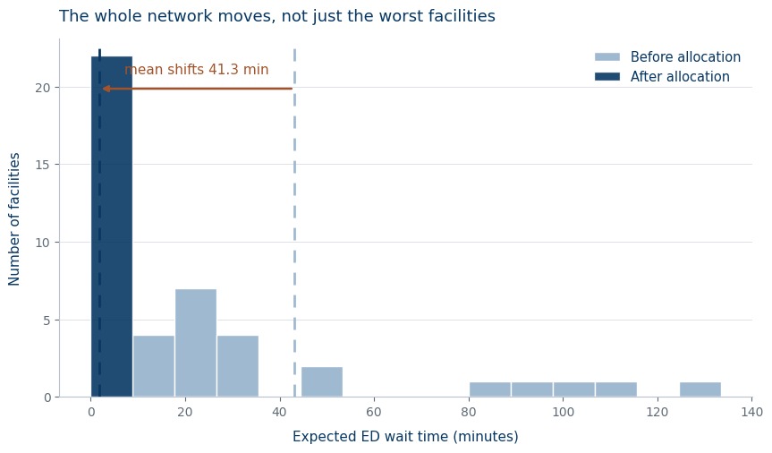
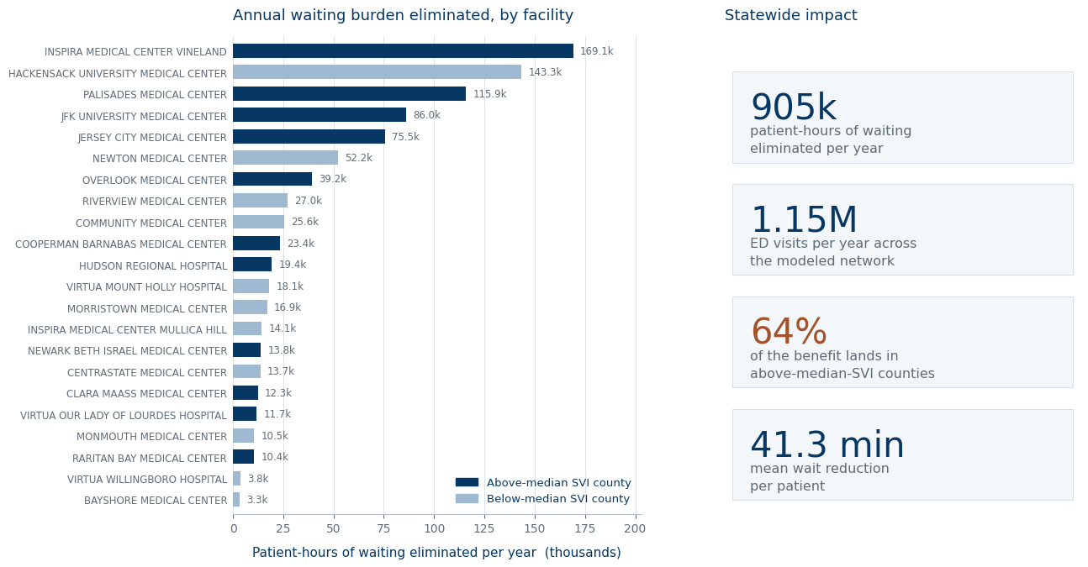
7
Impact
SLIDE 7
Impact — What 41 Minutes Means at Scale
Expected wait time across the network, before and after allocation.
INTERPRETATION
A 41-minute mean reduction is not distributed evenly, and it is not a one-time saving. Scaled by each facility's arrival rate across a full year, it represents a substantial reduction in aggregate waiting burden concentrated in the counties least able to absorb it.
Patient-hours of waiting eliminated per year, by facility. Navy bars are above-median-SVI counties.
Annual figures are modeled projections under the stated assumptions (μ = 2.55 patients/hr, bed-share arrival rates, steady-state M/M/c), not measured outcomes.
ASPIRE · Mathematical Research and Innovations
7
Notes:
Scaled across a year, the network sheds roughly 905 thousand patient-hours of waiting, and 64 percent of that benefit lands in above-median-vulnerability counties. The distribution plot shows the whole network moves, not only the worst facilities.

Slide 8
8
Conclusions, Limitations, Future Work
SLIDE 8
ACHIEVED
LIMITATIONS
FUTURE WORK
Recovered unobservable physician capacity for 22 NJ emergency departments by inverting an M/M/c queue against public CMS wait-time data
Arrival rates estimated by bed-share proxy, not measured directly
μ held constant, though Joseph et al. (2018) show physician productivity declines across a shift
M/M/c omits triage acuity classes, balking, and reneging
SVI measured at county level while hospitals are point locations
Mortality evidence linking wait time to harm is associational, not causal
Annual impact figures are modeled projections, not measured outcomes
1
Time-varying service rate
Replace the constant μ with a within-shift decay profile, so implied capacity is recovered against the productivity curve Joseph et al. (2018) measure rather than a flat average.
Proved uniqueness of the implied-capacity solution and established a (1 − 1/e) approximation guarantee for the allocation
2
Extension beyond New Jersey
Achieved a 41.30-minute mean wait reduction while directing the majority of the benefit to above-median-vulnerability counties
The inversion needs only CMS wait times, bed counts and county volumes, all of which exist nationally — so the method generalizes state by state, and can be validated wherever staffing is actually reported.
Showed the equity–efficiency tradeoff in this network costs 0.1 minutes
41.3 MIN MEAN REDUCTION
PROXY ARRIVAL RATES
μ(T) WITHIN SHIFT
22 EDS INVERTED
Μ HELD CONSTANT
NATIONAL ROLLOUT
0.1 MIN EQUITY COST
COUNTY-LEVEL SVI
WAGE-CONSTRAINED
REFERENCES
1
Singer AJ, Thode HC Jr, Viccellio P, Pines JM. The association between length of emergency department boarding and mortality. Acad Emerg Med. 2011;18(12):1324–1329.
2
Roussel M, Teissandier D, Yordanov Y, et al. Overnight stay in the emergency department and mortality in older patients. JAMA Intern Med. 2023;183(12):1378–1385.
3
Augustine JJ. More advanced practice providers working in emergency departments. ACEP Now. 2017;36(9).
4
Joseph JW, Davis S, Wilker EH, et al. Modelling attending physician productivity in the emergency department: a multicentre study. Emerg Med J. 2018;35(5):317–322.
5
Nemhauser GL, Wolsey LA, Fisher ML. An analysis of approximations for maximizing submodular set functions. Math Program. 1978;14(1):265–294.
6
Data: CMS OP_18b; HCRIS 2023; NJSHAD county ED volumes; CDC/ATSDR Social Vulnerability Index.
ASPIRE · Mathematical Research and Innovations
8
Notes:
What was achieved, what the model does not capture, and where it goes next. The largest open items are a time-varying service rate and a wage-constrained variant that makes headcount an output rather than an input.

Slide 9
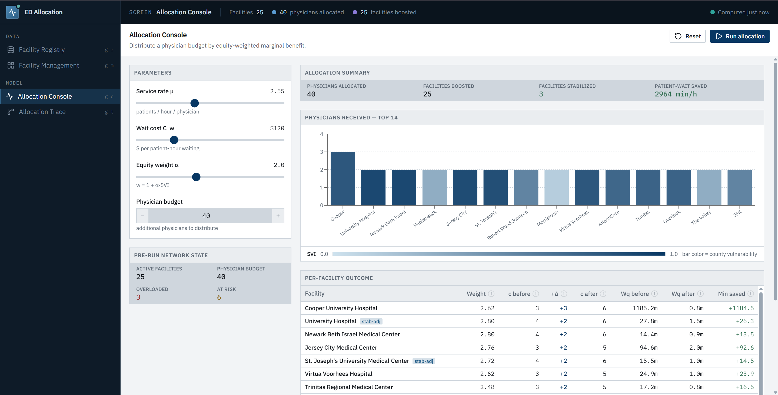
9
Application for Hospital Networks
SLIDE 9
From Model to Tool
ASPIRE · Mathematical Research and Innovations
9
Notes:
Placeholder — the hospital-network application goes here.

Slide 10


10
Contact & Resources
SLIDE 10
NAME
Rithvik Sharma
EMAIL
rs20psr@gmail.com
QR code
GITHUB
https://github.com/RithvikS1/ed-allocation-research.git
placeholder
MENTOR
Professor Padhu Seshaiyer, George Mason University
PROGRAM
ASPIRE — Mathematical Research and Innovations
Scan for Web App!
ASPIRE · Mathematical Research and Innovations
10
Notes:
Slides, code and the data-preparation notebooks are in the repository. Thank you — I'm glad to take questions.

